Slide 1
Exceptions
Error Handling and Recovery
  “One of the most powerful ways to improve program
  robustness”
Bruce Eckel
December 2009
- <number> -

Slide 2
Exceptions
Error Handling and Recovery
  Errors should not be allowed to propagate unnecessarily
  When an error detected by application
    May be possible to Fix and Retry
    Other cases Fixing not possible
  When a procedure ….
    Encounters error and returns to caller
      Procedure must perform necessary clean-up
      Procedure should not leak any resources
December 2009
- <number> -

Slide 3
Exceptions
C++ Exception Handling
  C++ exception model introduces 3 new key words
      try,
      throw,
      catch
December 2009
- <number> -

Slide 4

Exceptions
Traditional Error Handling
  None - ignore
  Immediate mode handling
    Assert
    Error handler of sorts
    Goto
    C library functions
      setjmp()
      longjmp()
    Return value from a function
December 2009
- <number> -

Slide 5
Exceptions
C++ Exception Handling
  Allows the Management of Runtime Error in an Orderly Fashion
  Built-in Exception Handling
    Automates much of the process
    Removes error handling from the main line of program execution
December 2009
- <number> -

Slide 6
Exceptions
Simple Exceptions
/*
* C++ Exceptions - Exception Handlers 1.0
* A Simple Exception Handler for Divide By Zero Errors
*/
#include <iostream>
using namespace std;
float quotient(int num1, int num2);
// Define the exception class
class DivideByZeroError
{
public:
  DivideByZeroError() : message("OOPs gotta Problem!!!!") { }
  void printMessage() {cout << message << endl;}
private:
  char* message;
};
December 2009
- <number> -

Slide 7
Exceptions
int main()
{
  int num1, num2;
  cout << "Enter two ints: ";
  cin >> num1 >> num2;
  try
  {
    float result = quotient (num1, num2);
    cout << "The result is: " << result << endl;
  }
  catch (DivideByZeroError handleError)
  {
    handleError.printMessage();
    cout << endl;
    return 1;
  }
  return 0;
}
float quotient (int num1, int num2)
{
  // Throw an exception if divisor == 0
  if (num2 == 0)
  // Construct exception object
  throw DivideByZeroError();
  return (float) num1 / num2;
}
December 2009
- <number> -

Slide 8

Exceptions
Try Block
  Encloses the code that may cause exceptions
  Point where exception thrown throw point
Syntax
try
{
  code
}
December 2009
- <number> -

Slide 9
Exceptions
Catch Block
Parameter
Specifies the type of exception it can handle
UnNamed
  Only a type is listed
  No Information Conveyed
  Only control is passed
Named
  Parameter can be referenced in handler
Control
  No Exception
  Exception
    Leave try block
    Search catch block
    Match - Handle
    No Match - Try next enclosing block
catch (exceptionType exception)
{
code
}
Catch all exceptions
catch (…)
{
code
}
December 2009
- <number> -

Slide 10
Exceptions
Matching Rules
  1. The catch handler parameter and thrown object are an exact match.
  2. The catch handler parameter is a public base class of the class of the thrown object.
  3. The catch handler parameter is a pointer type and the thrown object is a pointer type convertible to a catch handler parameter type through an allowable handler conversion.
  4. The catch handler is of the form (…).
December 2009
- <number> -

Slide 11

Exceptions
Catching an Exception
The handler that catches the exception….
  The first one listed following the active try block that matches the type of the thrown object.
Caution….
  Order is significant
December 2009
- <number> -

Slide 12
Exceptions
Handling the Exception
1. Examine the error and decide to terminate.
2. Can generate an exception.
3. Re-throw an exception.
4. Can perform the necessary recovery and resume execution after the last exception handler.
5. Examine the cause of the error and retry by calling the original function.
6. Return a status value to the environment.
December 2009
- <number> -

Slide 13

Exceptions
Throw
  Used to indicate an exception has occurred
  When thrown, the exception is initially caught by the closest exception handler
  If the exception is a class type object
    An instance of the object is created
    Class constructor is called
Syntax
  throw exceptionName (<exception>)
    exception - any type
      class type
      built-in
December 2009
- <number> -

Slide 14
Exceptions
Exception Specification
Syntax
  returnType functionName( <parameters>) throw(<exceptionTypes>)
    exceptionTypes - comma separated list of possible exception types
      states: only exceptions of type exceptionType_{i} can be thrown.
    returnType functionName( <parameters> )
      states: exceptions of any type can be thrown.
    returnType functionName( <parameters>) throw( )
      states: the function throws no exceptions.
December 2009
- <number> -

Slide 15

Exceptions
Unexpected
  If a function throws an exception that is not in the exception
  specification, the specification is violated
    Default Response
    Terminate the program
    Programmer Specified Response
    Provide an unexpected handler
December 2009
- <number> -

Slide 16
Exceptions
Unexpected Handler
  Prototype in <unexpected>
Syntax
  set_unexpected( void (*unexpectedHandler)( void) )
    unexpectedHandler - pointer to a function
    return value - the previous value of the unexpected( ) pointer.
December 2009
- <number> -

Slide 17
Exceptions
Unexpected Handler
class except0 {};
class except1 {};
void g ();
// Specify the the exception list
void f(int i) throw (except0, except1)
{
switch(i)
{
  case 1: throw except0();
  case 2: throw except1();
}
void g()
{
  throw 47;
}
December 2009
- <number> -

Slide 18
Exceptions
void myUnexpected()
{
  cout << "Whoa, I didn't expect to see you!!!!" << endl;
  exit(1);
}
int main(void)
{
  set_unexpected (myUnexpected);
  for (int i = 1; i <=3; i++)
  {
    try
    {
      f(i);
    }
    catch(except0)
    {
      cout << "Caught except0 over here"<< endl;
    }
    catch(except1)
    {
      cout << "Caught except1 in here"<< endl;
    }
  }
  return 0;
}
December 2009
- <number> -

Slide 19

Exceptions
Terminate Function
  Prototype in <terminate>
Syntax
  set_terminate( void (*terminateFunction)( void) )
    terminateFunction - pointer to a function
    return value - the previous value of the terminate( ) pointer.
December 2009
- <number> -

Slide 20

Exceptions
Rethrowing an Exception
  The exception handler may decide
    Not to handle the exception
    Clean up resources first
  The rethrown exception
    Detected by the next higher enclosing try block
    Handled by the exception handler following that block
December 2009
- <number> -

Slide 21
Exceptions
Constructors and Destructors
  Problem:
  What if new fails in a constructor?
    A constructor cannot return a value
    There is no way to tell the outside world a failure has occurred
    Destructors have a similar problem
December 2009
- <number> -

Slide 22


Exceptions
Tasks…..
  Must inform the outside world - ok…how?
    Return an improperly formed object
    Set some variable outside the constructor
    Throw an exception
December 2009
- <number> -

Slide 23
Exceptions
Tasks….
  Must clean up partially constructed objects
    Exceptions thrown in a constructor invoke destructors
    Destructors are called for any auto objects constructed in a try block before an exception is thrown - Stack Unwinding
    Handle exceptions during stack unwinding
  Catch exceptions from a destructor
    Enclose the function in a try block
    Provide a catch handler for the proper type
December 2009
- <number> -

Slide 24
Exceptions
Exceptions Hierarchy
  Exception Classes
    Can be derived from a common base class
    Exception handlers written to handle the base class can catch all objects derived from the base class
Note:
  If catch blocks for related exception objects follow the same try block….
  …place the base class object after the derived class object
December 2009
- <number> -

Slide 25
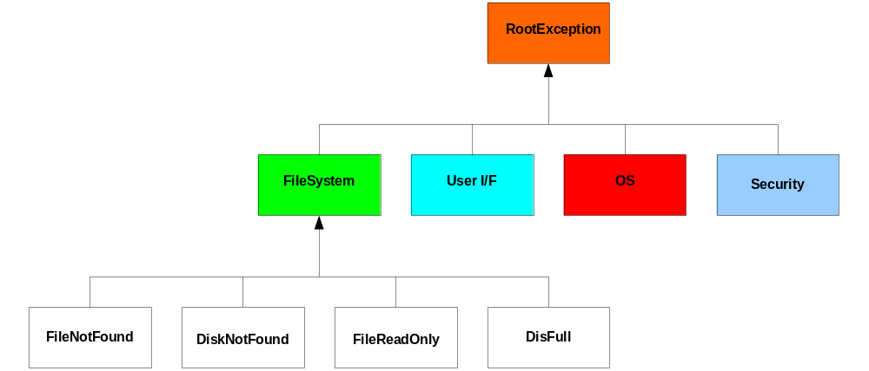
Exceptions
Exceptions Hierarchy
December 2009
- <number> -

Slide 26
Exceptions
Standard Exceptions
  Exceptions from the Standard C++ Library are available for use
  Start with these and derive as necessary
December 2009
- <number> -

